Slide 1



Harmonic Global Parametrization with Rational Holonomy
Alon Bright^{1,*}, Edward Chien^{1,2,*}, Ofir Weber¹
¹Bar-Ilan University
²Massachusetts Institute of Technology
*Equal contributions
Notes:
Note Alon and Ofir are in the audience.
Better text and sync.
Slide numbers.

Slide 2
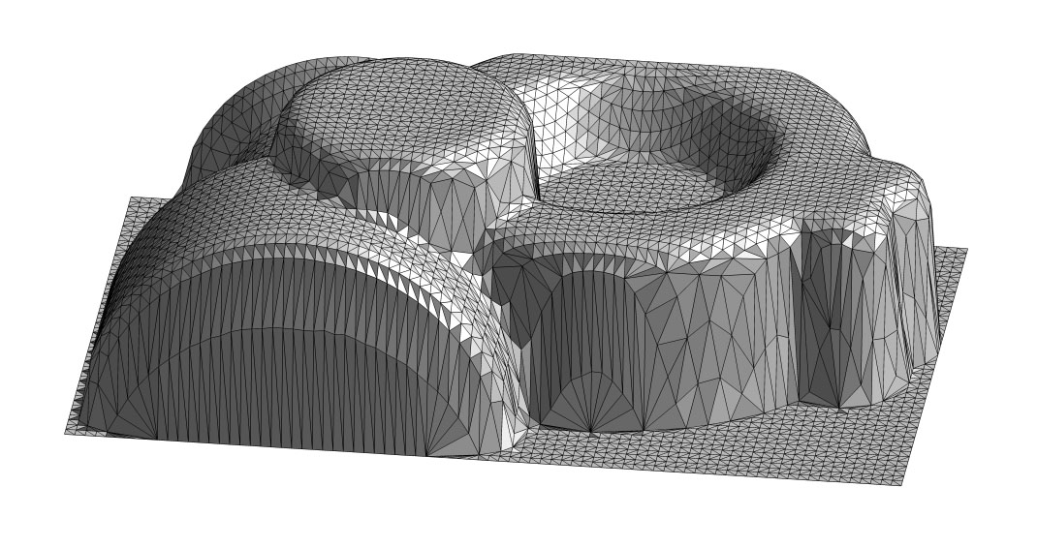
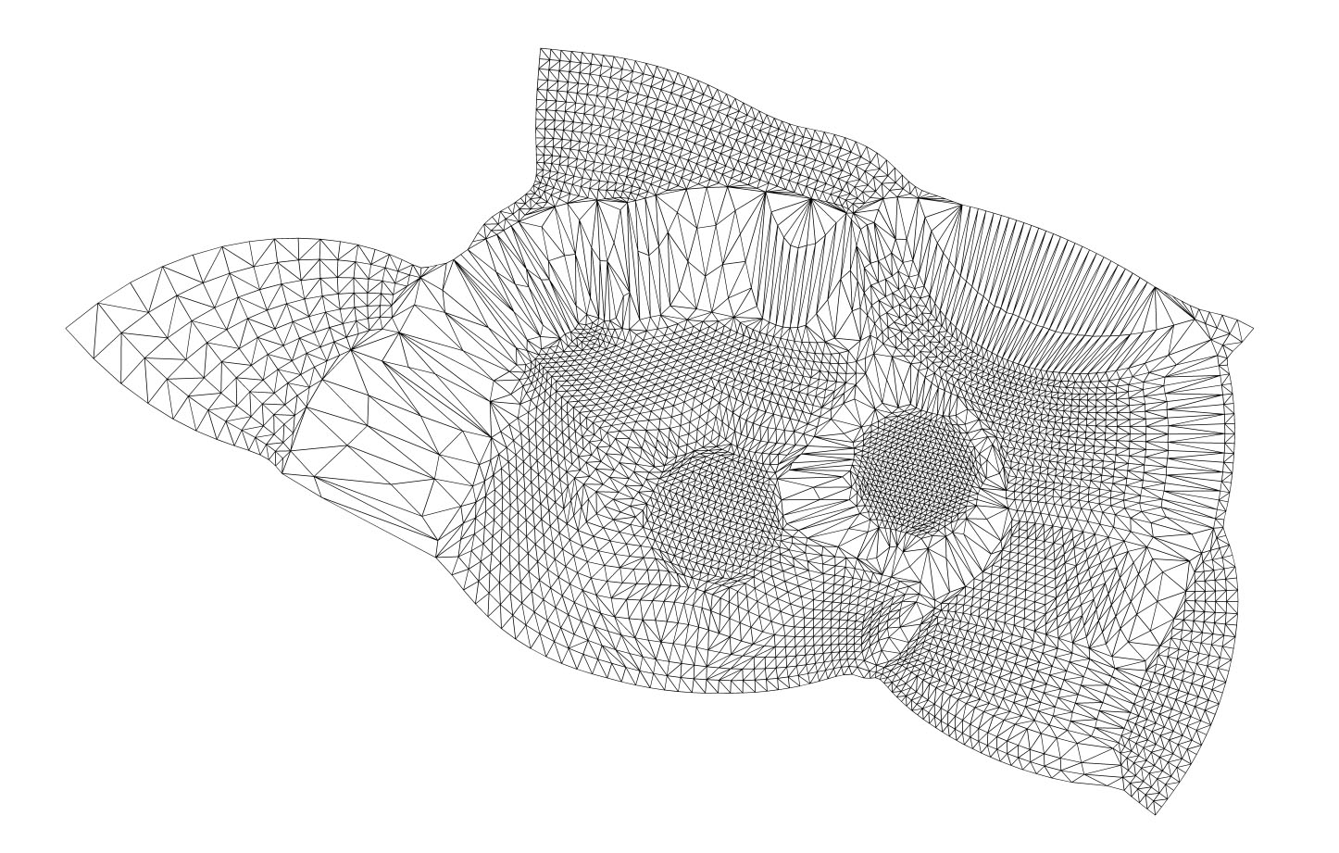
The Problem: Mesh Parametrization
Useful for:
texture application
remeshing
vector/directional field design
and more…
Notes:
Don’t linger

Slide 3
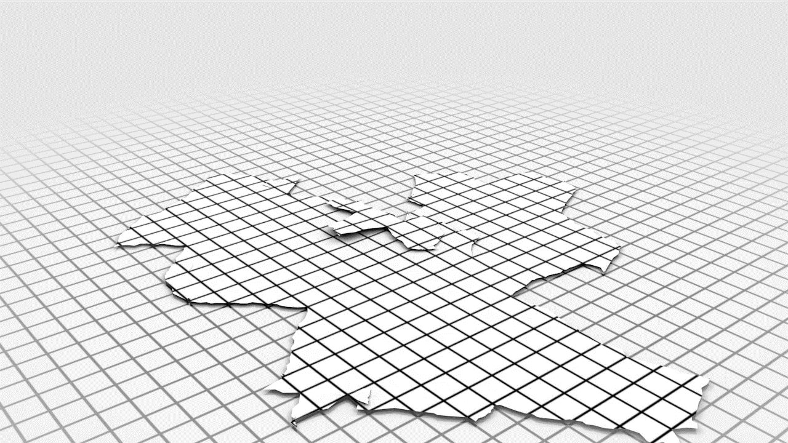
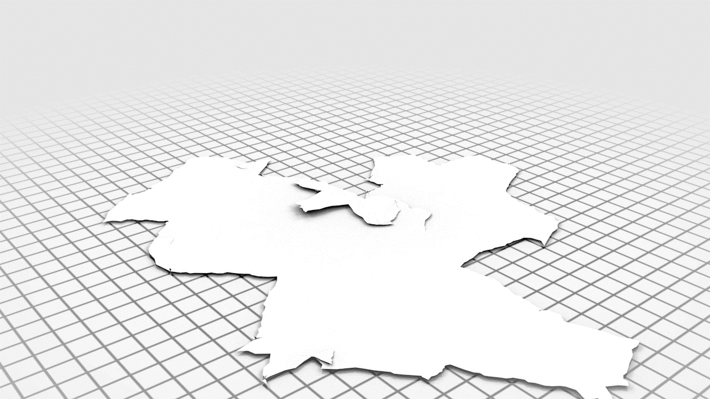
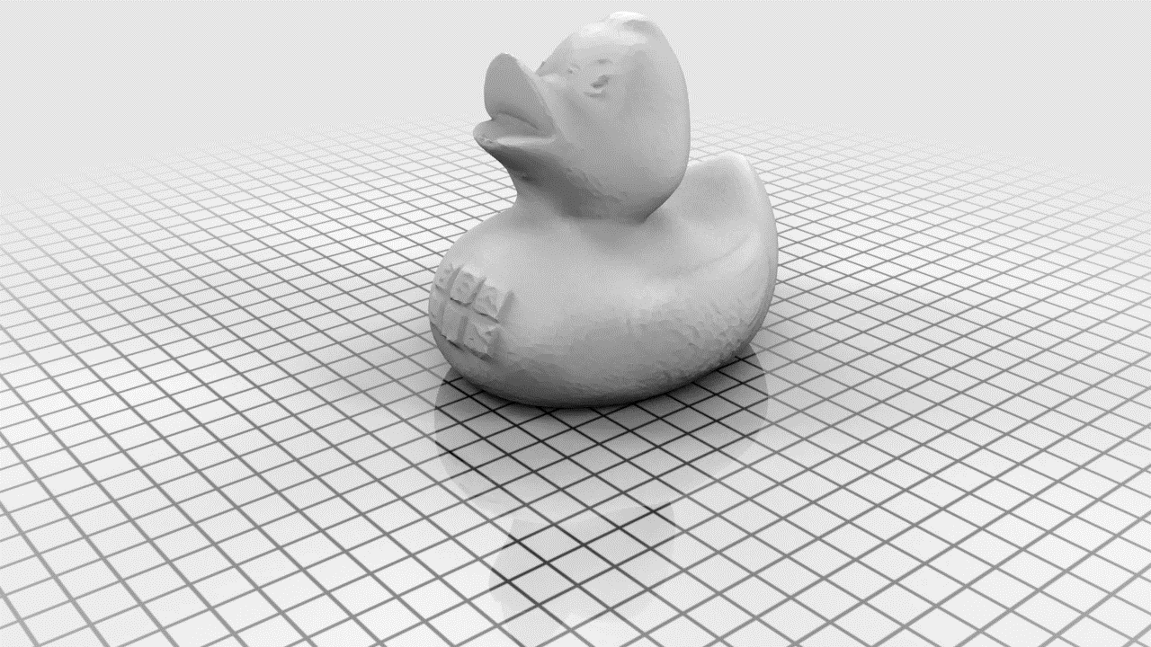
Credit: Hans-Christian Ebke
Quad Remeshing Example

Slide 4
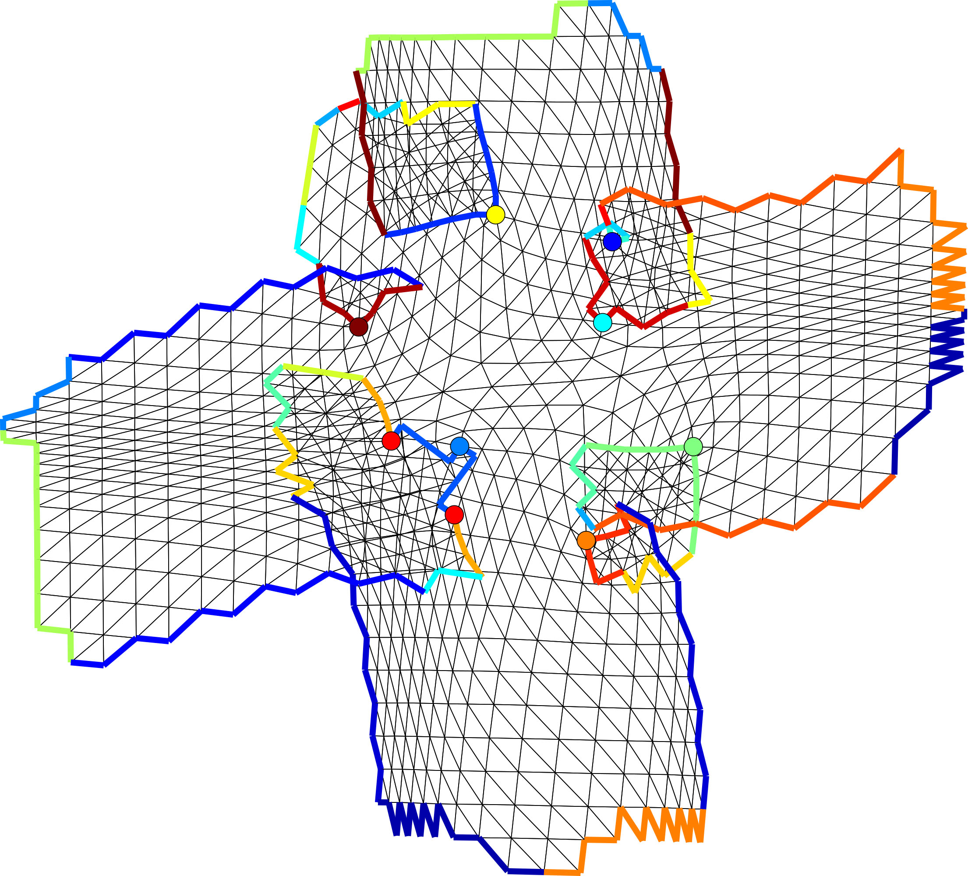
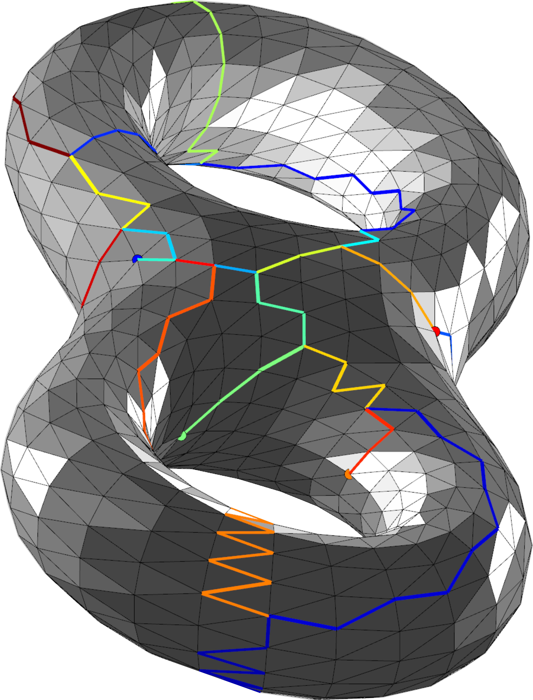
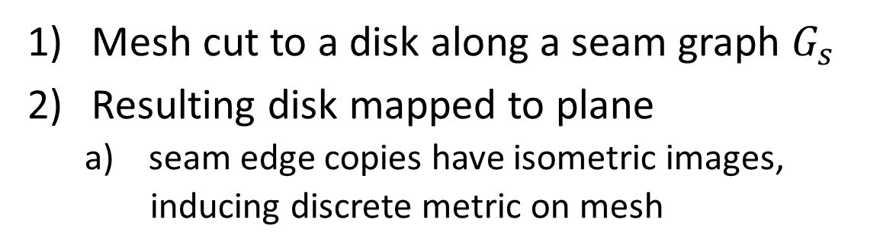
Global Parametrization
Mesh cut to a disk along a seam graph $G_{s}$
Resulting disk mapped to plane
  seam edge copies have isometric images,
  inducing discrete metric on mesh
  local injectivity necessary for many applications
Notes:
Make sure to move through two actions before noting local injectivity.
Again, figure out a short way to say these things.
-----------------------------
Should discuss cut seams need to have isometric images. The result is a pullback metric, which assigns a geometry to the original mesh.
The images of the edges and they need to be related by some rotation angle (2pi / k)
Could note that cones are also helpful for getting rid of distortion

Slide 5
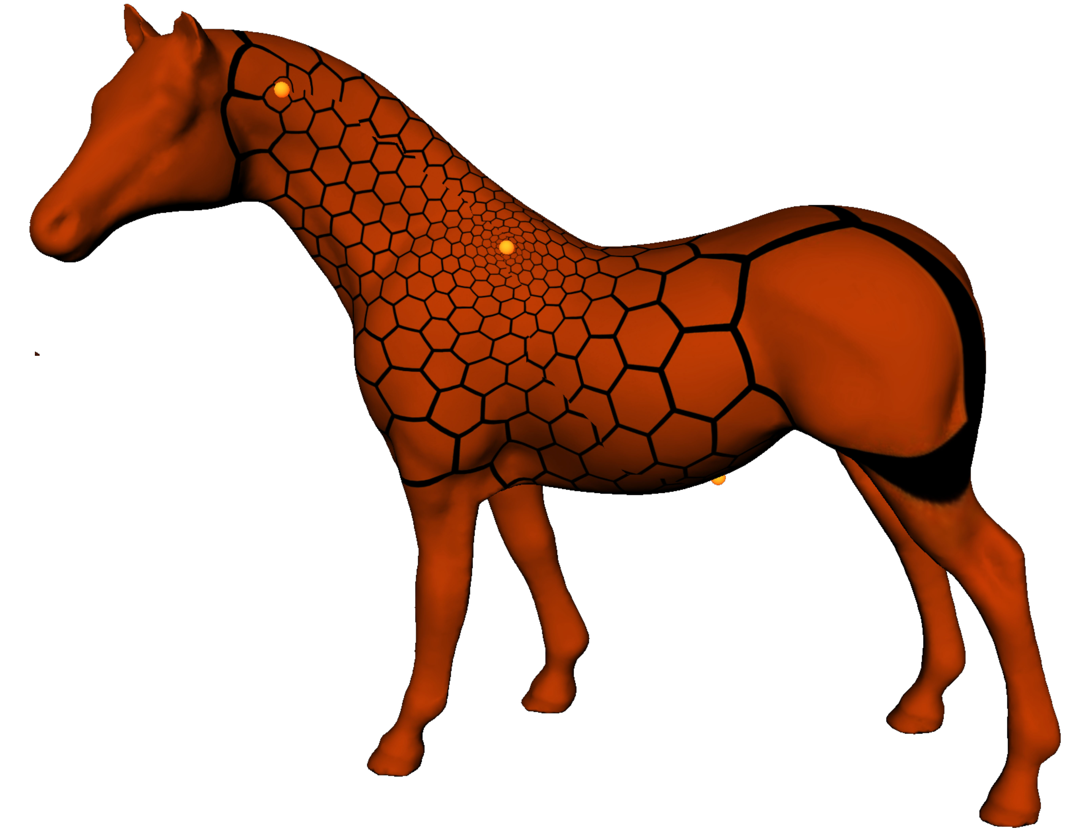
Rational Holonomy
Upshot: Rotational parts of the isometries are multiples of 2π/q for some positive integer q
  Specific multiples determined by the holonomy of the induced metric; details in [Myles and Zorin 2012]
Our algorithm (HGP) aims to produce global parametrizations with rational holonomy that are locally injective
  Desired cone points and holonomy are assumed to be given ([Bommes et al. 2009])
  Integer restrictions on translational parts of isometries needed for quad remeshing
q = 6
q = 2
q = 4
[Knoppel et al. 2015]
[Nieser et al. 2012]
Notes:
Again, move through more quickly.
4 min. to here
------------------------------------------------------
Translational parts are integer translations
The image of seam edge duplicates must are related by a rigid motion and the rotational parts are determined by the holonomy of the pullback metric.
In particular, the holonomy is the amount of angular defect that arises when a vector is parallel transported along a loop in the pullback metric.
When one cuts such a mesh into a disc, you specify generators of the homology group.
With H_1 (S\C), we have a homomorphism into Z/kZ
Use cone image, and refer to Myles and Zorin.

Slide 6
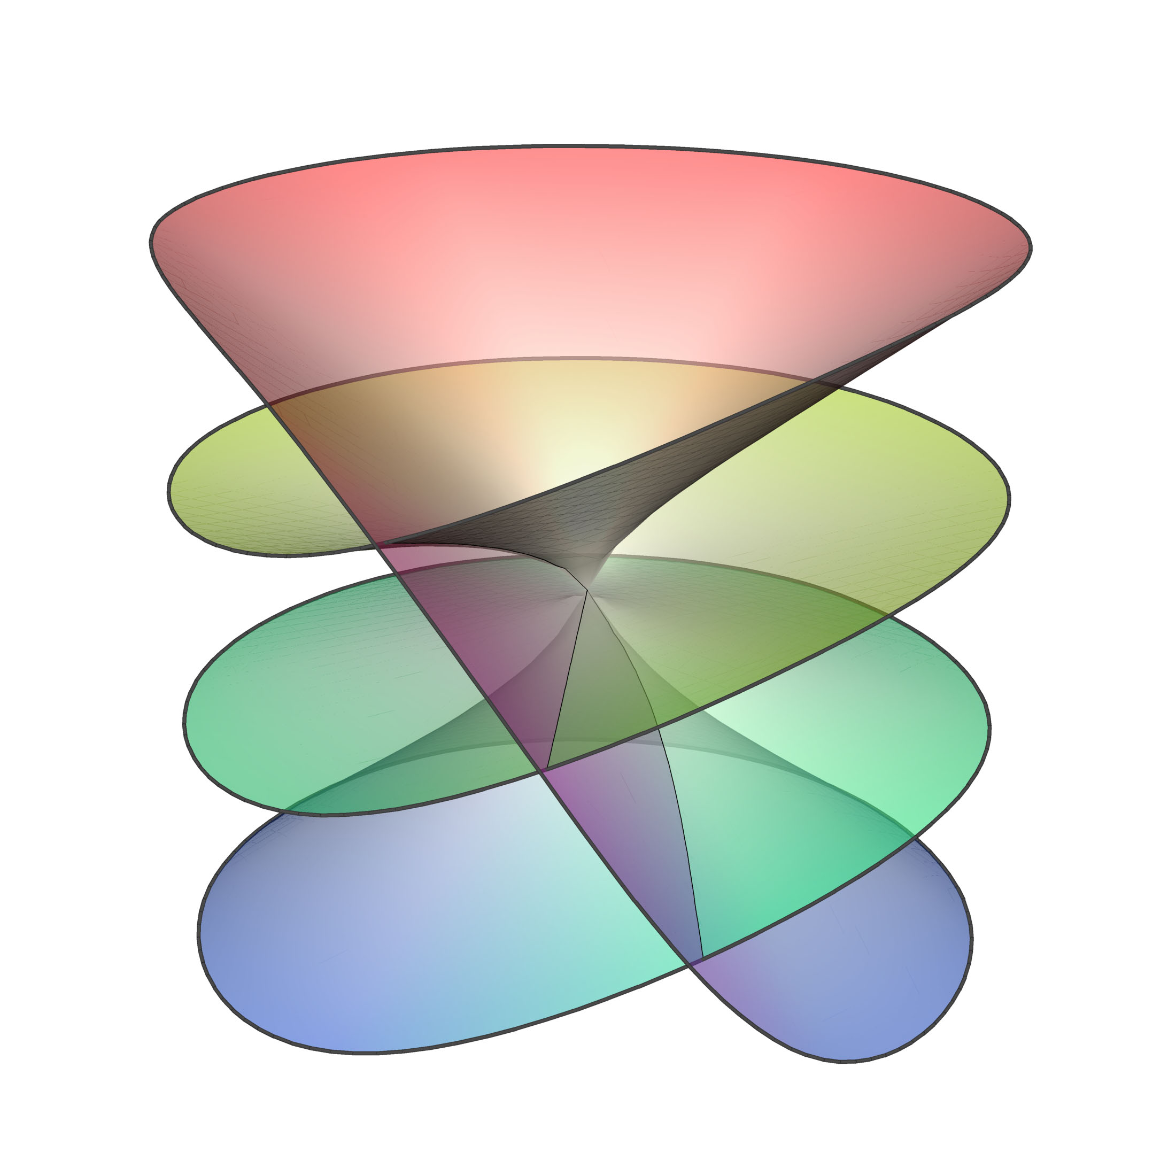
Related/Previous Works
Harmonic methods: [Tutte 1963] and [Gortler et al. 2006]
Orbifold methods: [Aigerman et al. 2015/2016/2017]
Convexification of injectivity: [Lipman 2012] and extensions
QuadCover [Kalberer et al. 2007] and others
Metric-based: [Chien et al. 2016b], conformal methods (e.g. CETM [Springborn et al. 2008])
Notes:
Start convexification frames terminology.
2 min. on this slide. 6 min. total
---------------------------------------------------------------------------------------
Harmonic methods do not address more complicated topologies
Orbifold methods only allow for cone angles of the form 2pi / k (not multiples), and have limited topology types for Euclidean orbifolds; hyperbolic not useful for many methods.
Convexification (Lipman) approaches: initialization required for every triangle, local fixes allowed
SIGASIA does not account for holonomy, and is quite slow, though it’s robust.
Myles/Zorin is slower, and requires mesh modification
Conformal approaches, robustness
Simplex assembly & Diamanti ?

Slide 7
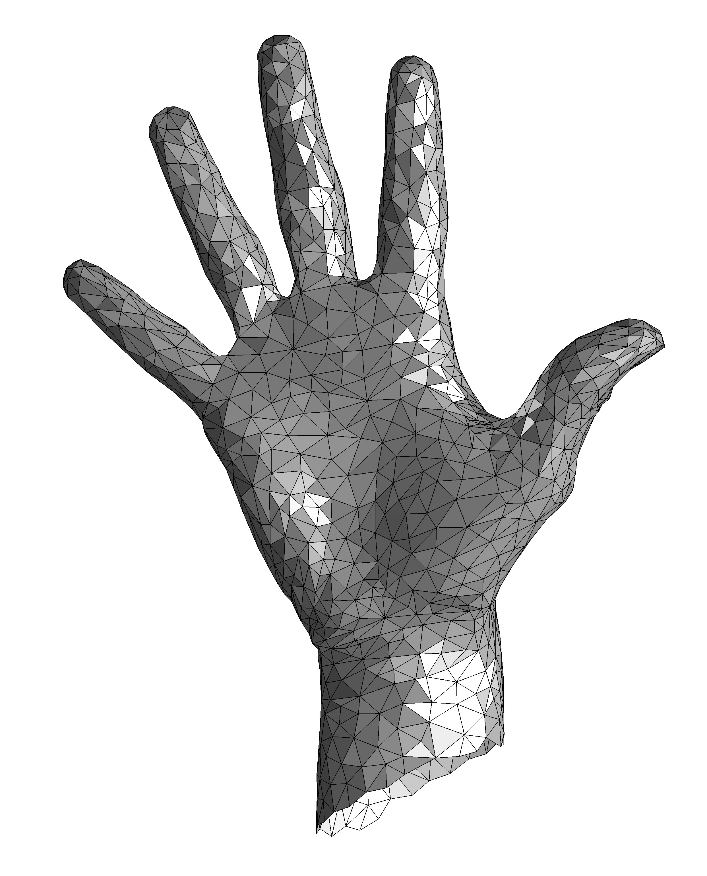
Tutte’s Harmonic System
Mesh disk with vertices V and boundary vertices B.
Arbitrary positive weights
Vertex images under parametrization
Guarantee: if B vertices placed as vertices of convex polygon
  → resulting map is globally bijective
Notes:
Note distortion.

Slide 8
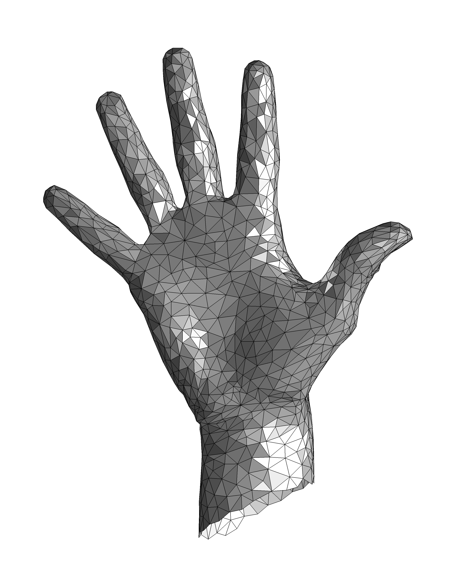
Nonconvex Target
Guarantee: if B vertices placed as vertices of nonconvex polygon,
  and boundary triangles at nonconvex regions are positively oriented,
  → resulting map is globally bijective [Gortler et al. 2006]
Notes:
Note distortion.

Slide 9
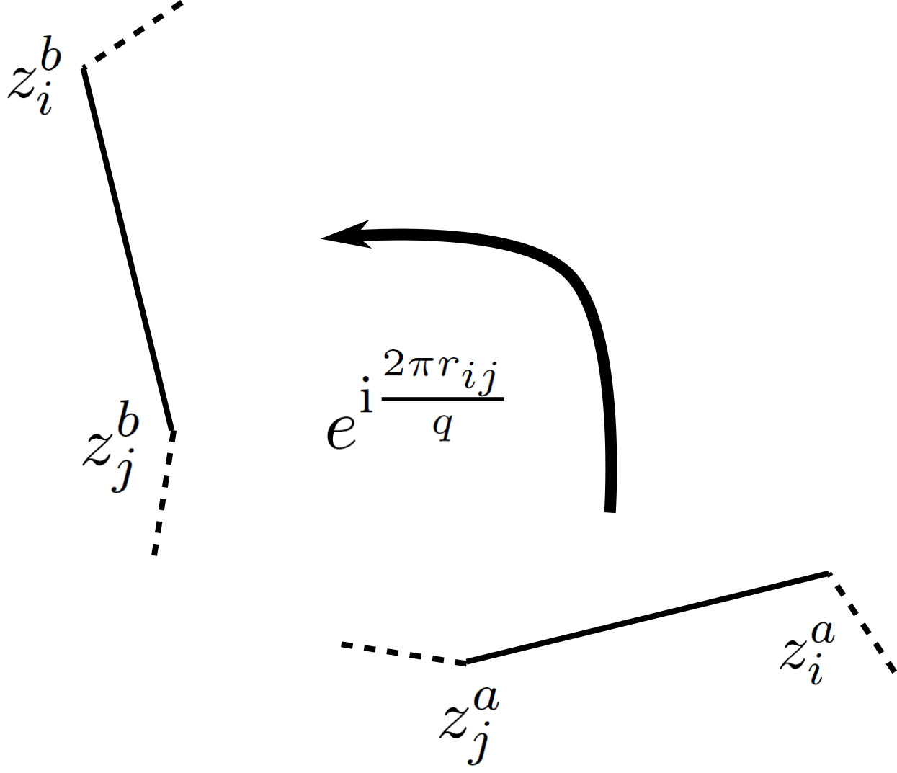
An Analogous System
An analogous system for global parametrization:
Pairs of seam vertex copies
Harmonicity for non-cone vertices of $G_{s}$ on next slide…
Notes:
Figure out how to talk about the second slide quickly.

Slide 10
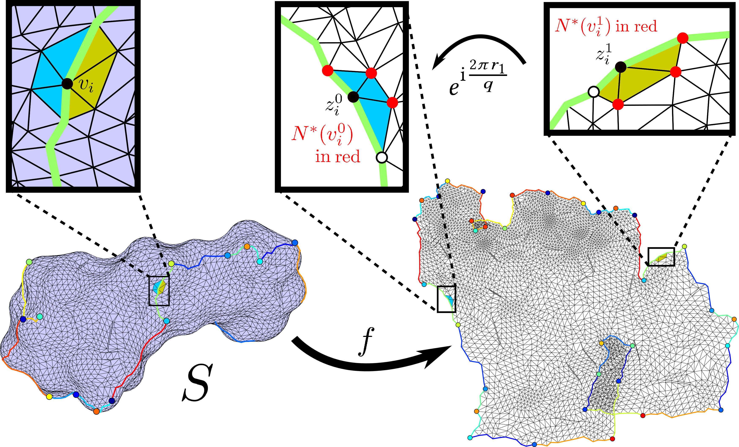
An Analogous System
System inspired by [Aigerman et al. 2015]

Slide 11
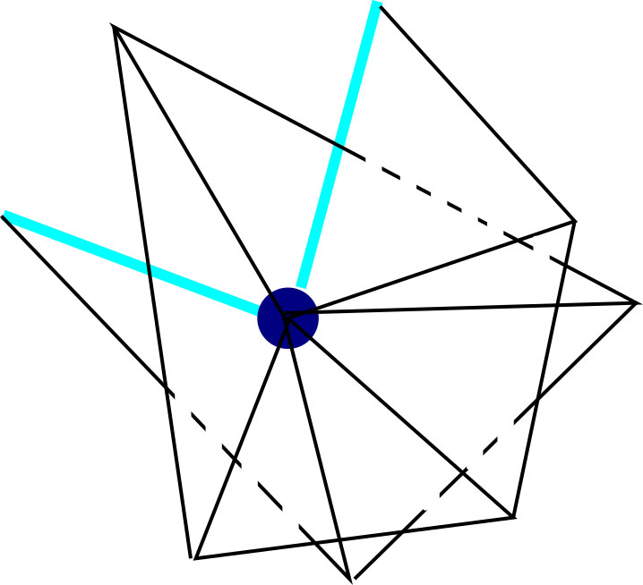
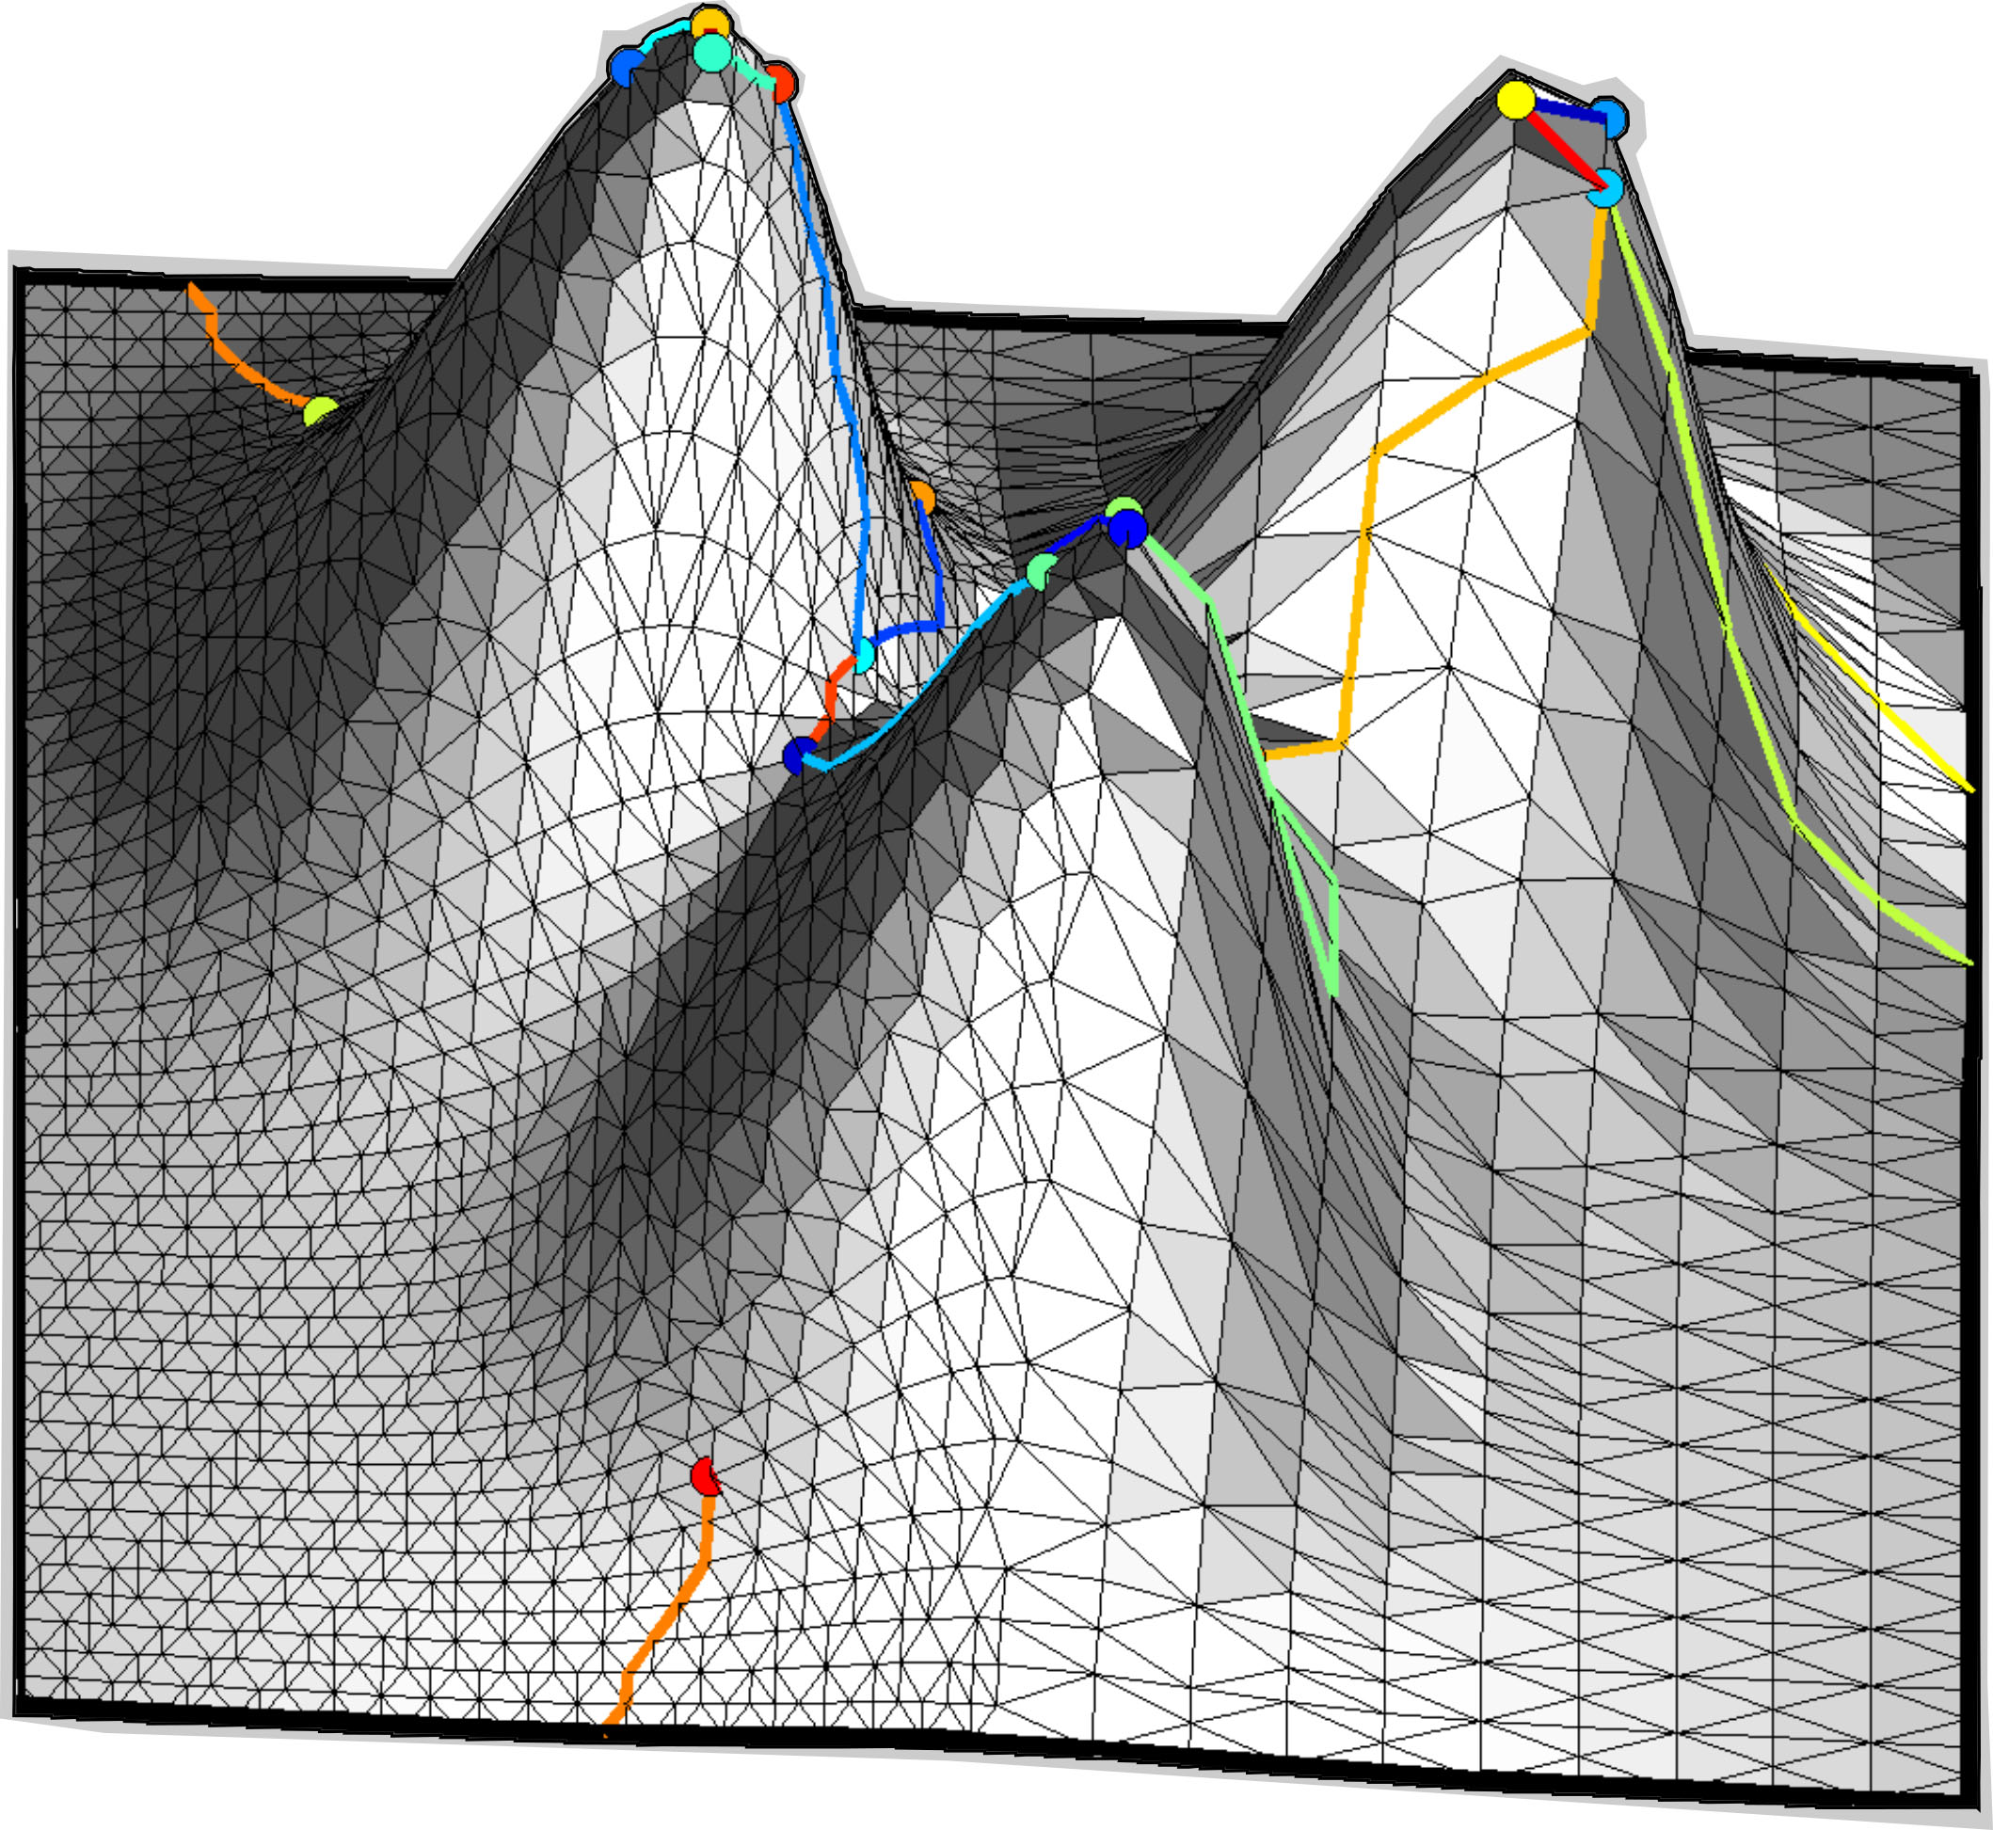
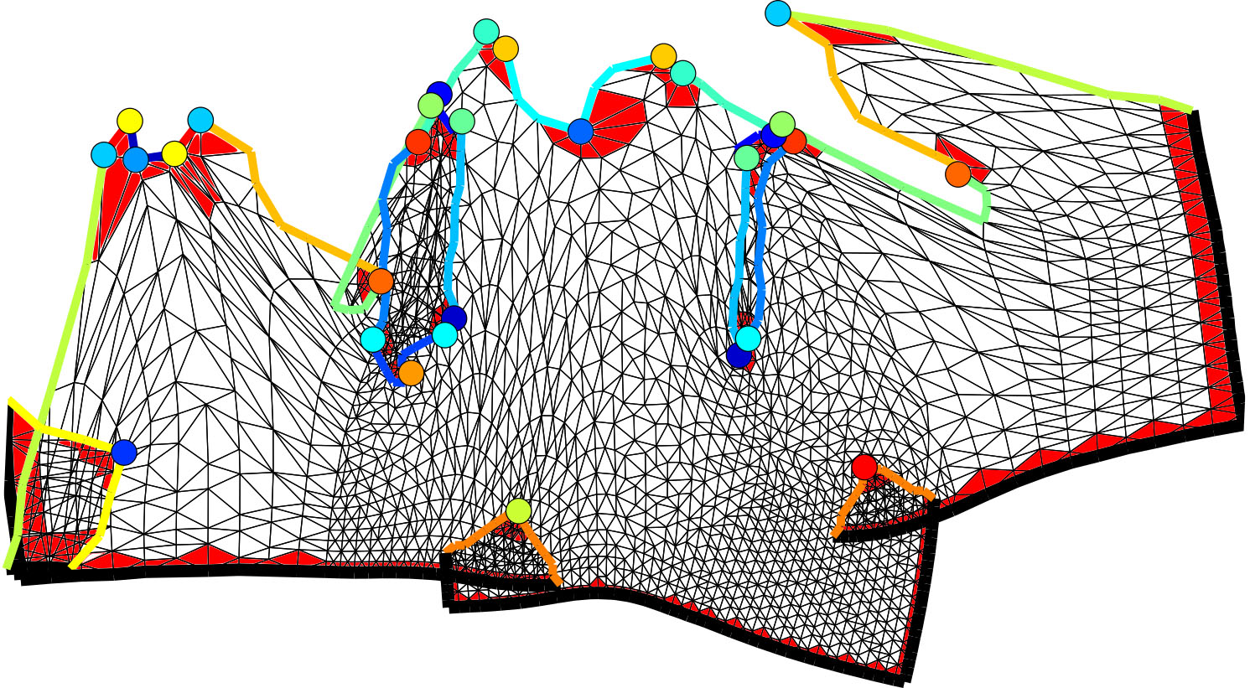
Local injectivity guarantee
Wrong angle
example
Main theoretical result: Given a solution to our system,
  if the boundary and cone triangles are positively-oriented with correct winding and cone angles,
  → resulting map is locally injective
Notes:
7 min. on these slides; 12 min. total
What is definition of winding number?
Give some intuition about the proof of the result.
Reinforce domain of applicability
Add diagram with winding number

Slide 12
Optimization
LHS of harmonicity conditions in a Laplacian-like matrix L
quadratic
linear
Convexification frames
convex
Frames & induced metric from [Bommes et al. 2009]
Mosek used for optimization
Notes:
Find exact statistics
Note kind of optimization (quadratic energy over convex region)
Actual problem is nonconvex
Note Laplacian info
Note frame stuff, and source of frame information

Slide 13
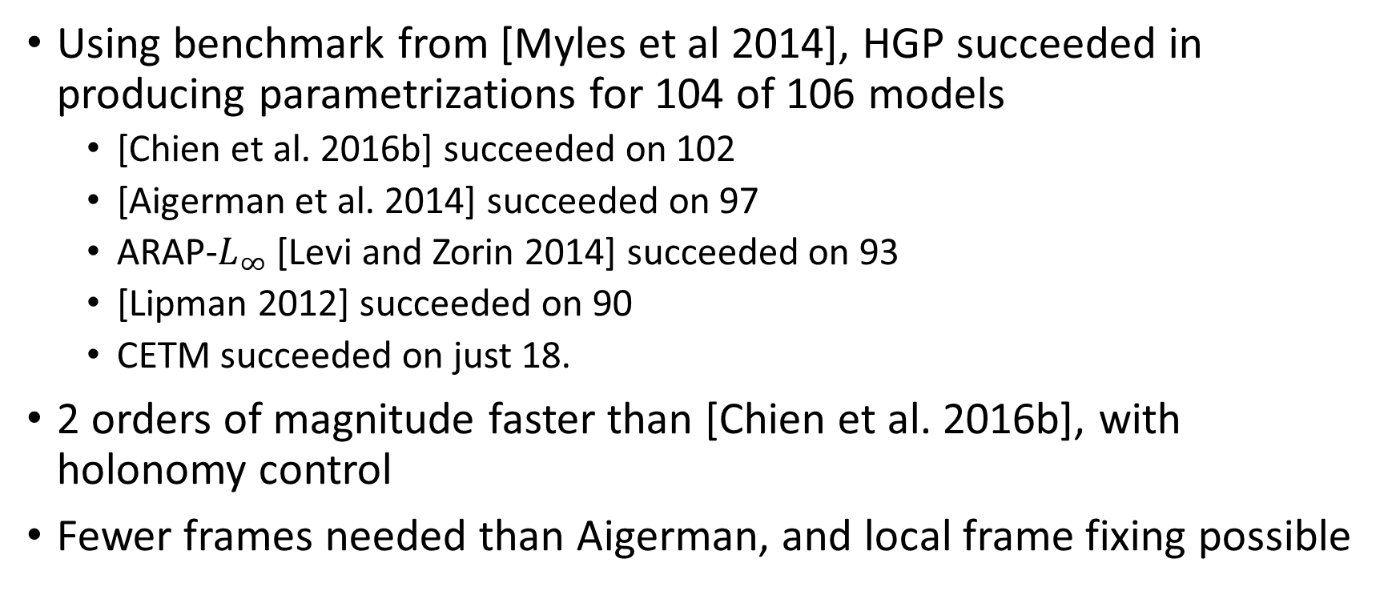
Robustness & Running Times
Using benchmark from [Myles et al 2014], HGP succeeded in producing parametrizations for 104 of 106 models
  [Chien et al. 2016b] succeeded on 102
  [Aigerman et al. 2014] succeeded on 97
  ARAP-$L_{∞}$ [Levi and Zorin 2014] succeeded on 93
  [Lipman 2012] succeeded on 90
  CETM succeeded on just 18.
2 orders of magnitude faster than [Chien et al. 2016b], with holonomy control
Fewer frames needed than Aigerman, and local frame fixing possible

Slide 14
More results
Four challenging models from the benchmark, and the resulting checkerboard pattern. [Chien et al. 2016b] required over an hour for all of them together. HGP took less than a minute.
Notes:
Quality comparison?
Layouts?
Hex example?
Frame fixing?
Robustness test. We present results of our method (HGP) for four challenging models from the \protect\cite{myles2014:fieldtrace} benchmark. Many other state-of-the-art methods: \protect\cite{aigerman2014lifted}, \protect\cite{levi2014strict}, \protect\cite{springborn2008cet}, failed to produce locally injective seamless parametrization maps. The method of \protect\cite{chien2016metric} managed to produce locally injective maps, but required more than an hour to parametrize the four models above. HGP required just one or two iterations of a second-order cone program (SOCP) per model, and took less than a minute. The heat maps illustrate the conformal distortion $k$ and show that we produce maps with relatively low distortion. The cone points are denoted by the colored dots.

Slide 15
Conclusion
Natural theoretical extension of [Tutte 1963] and [Gortler et al. 2006]
Works on all mesh topologies and geometries with rational holonomy
Convexification frames only needed on cone and boundary triangles, and frame fixing possible
Resulting algorithm is simple, robust, and fast
Future work: control distortion, better frame & geometry determination

Slide 16
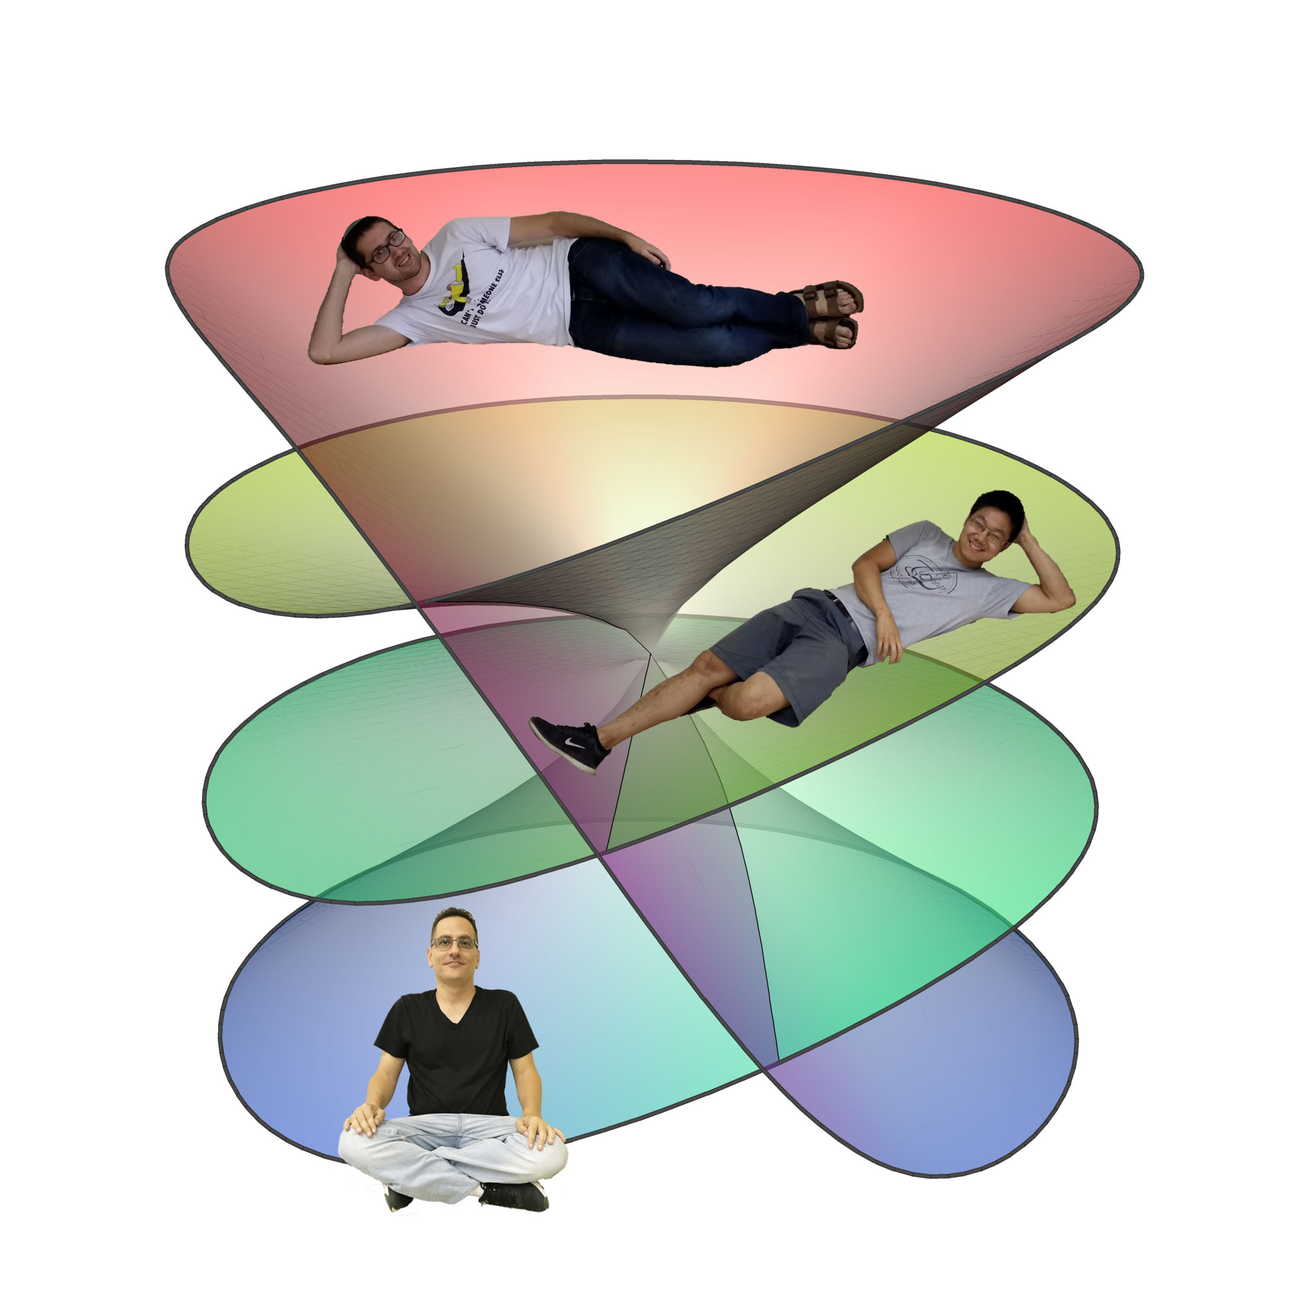
Thank you! Questions?
Notes:
What are some examples of other uses for locally injective parametrizations?
Where did you get the seam graphs? Seam graph arbitrary

Slide 18
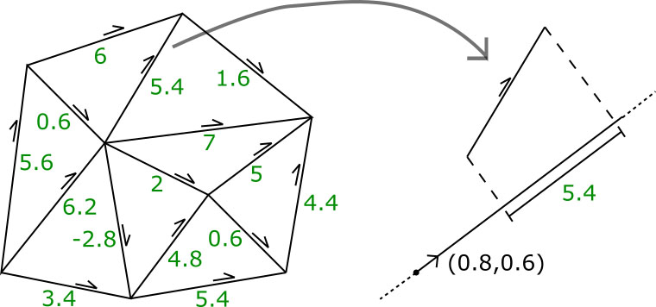
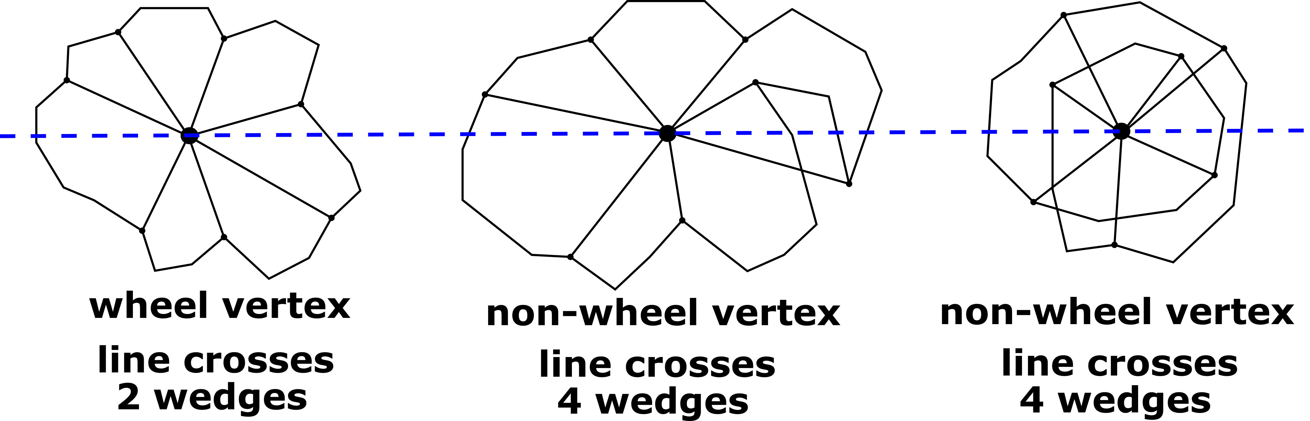
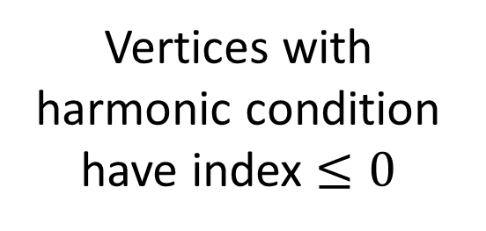
Proof Outline (I)
Consider such 1-forms from the mapping
Index = 0 (2 sign changes) desired for local injectivity
Vertices with harmonic condition have index $≤0$
Notes:
What is the basic proof outline?
If there were any flips, there would have to be a non-cone, interior vertex with negative index for some particular 1-form.
For a harmonic 1-form, the indices of these vertices are necessarily non-positive.
Topological arguments guarantee index contributions are set when cone and boundary vertices are particularly well-behaved. Bring in Hopf-Poincare and we are done.

Slide 19
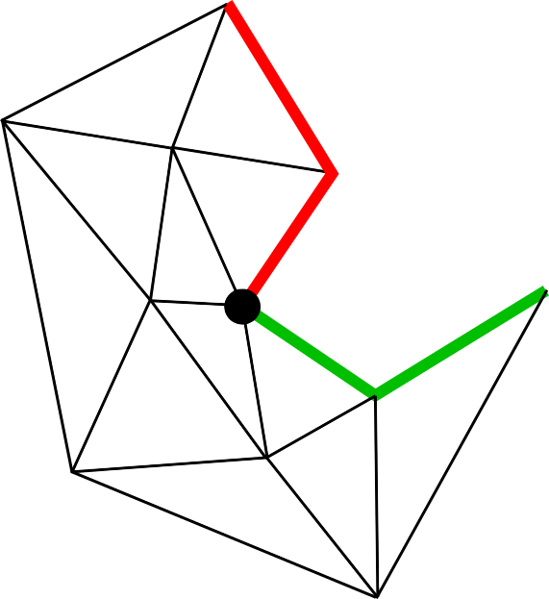
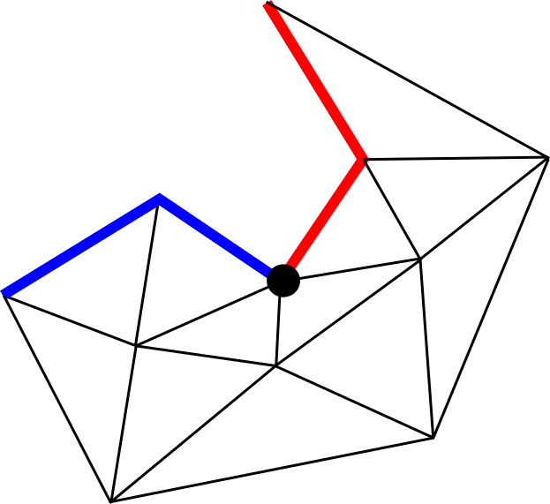
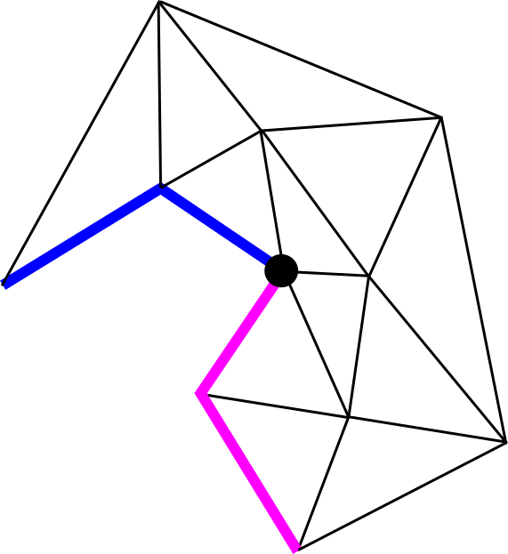
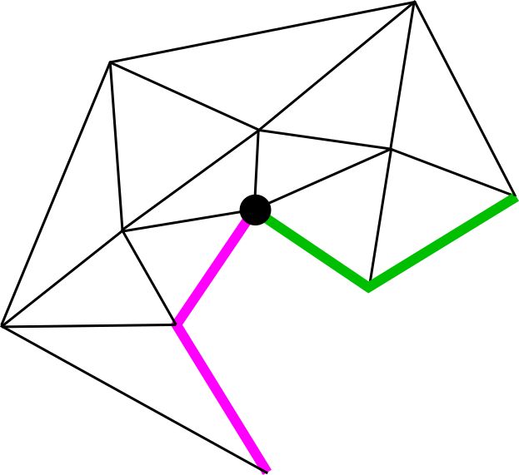
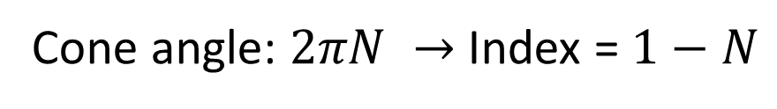

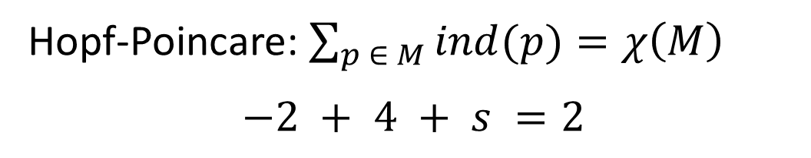

Proof Outline (II)
Riemann-Hurwitz!
Toy example: cone mesh with $3π/2$ cone angle
Hopf-Poincare: $\sum_{p ∈ M}{ind(p)}=χ\left(M\right)$
$$−2 + 4 + s =2$$
Cone angle: $2πN →$ Index = $1−N$
Winding angle: $2πφ →$ Index = $1+φ$
$s = 0$, local injectivity!
Notes:
Cone angle: 2piN => Index = 1-N
Winding angle: 2piPhi => Index = 1+ Phi
-2 + 4 + s = 0

